Slide 1



DEPLOY THREE-TIRE ARCHITECTURE IN AWS USING TERRAFORM
Yashwanth Naidu

Slide 2
Introduction to Terraform
Terraform is an open-source Infrastructure as Code (IaC) tool developed by HashiCorp that allows you to define, provision, and manage infrastructure across various cloud providers using a declarative configuration language.
Purpose of the Project:
Deploy a three-tier architecture in AWS.
Automate the provisioning of cloud infrastructure using Terraform.

Slide 3

Three-tier architecture: Web tier, Application tier, and Database tier.
AWS Services Used:
EC2 instances
VPC, Subnets,
Internet Gateway,
Route Tables,
Security Groups,
Load Balancer, Target Groups
Auto Scaling,
RDS.
Project Overview

Slide 4
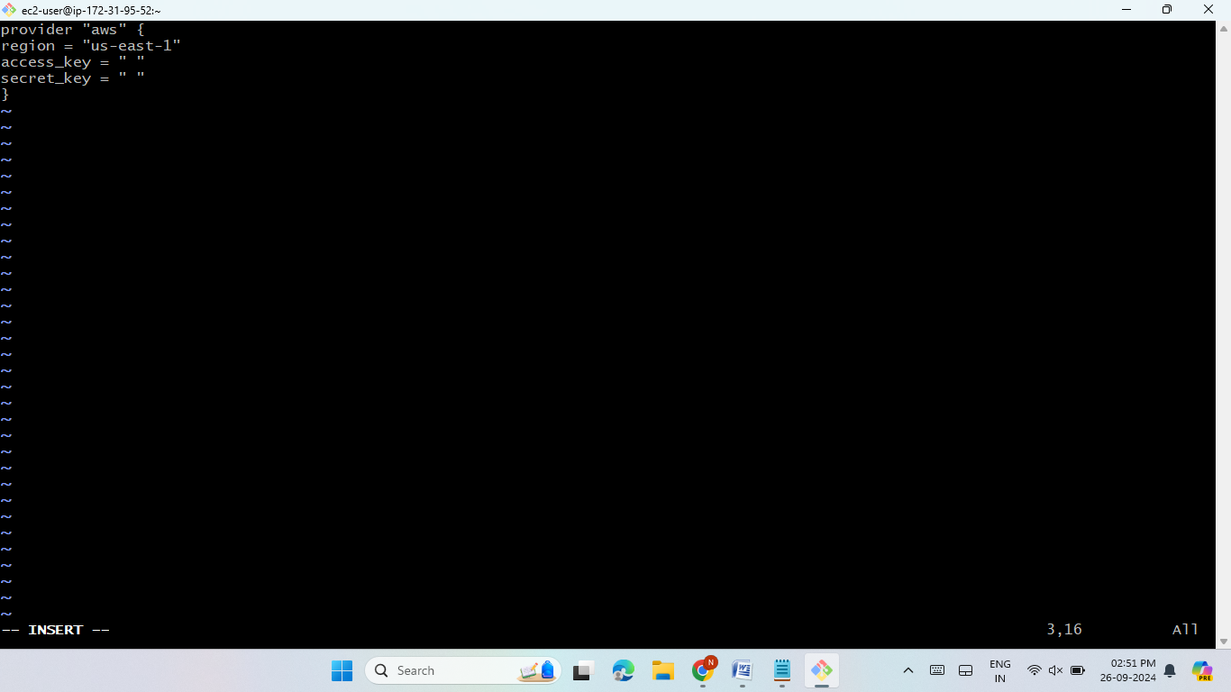
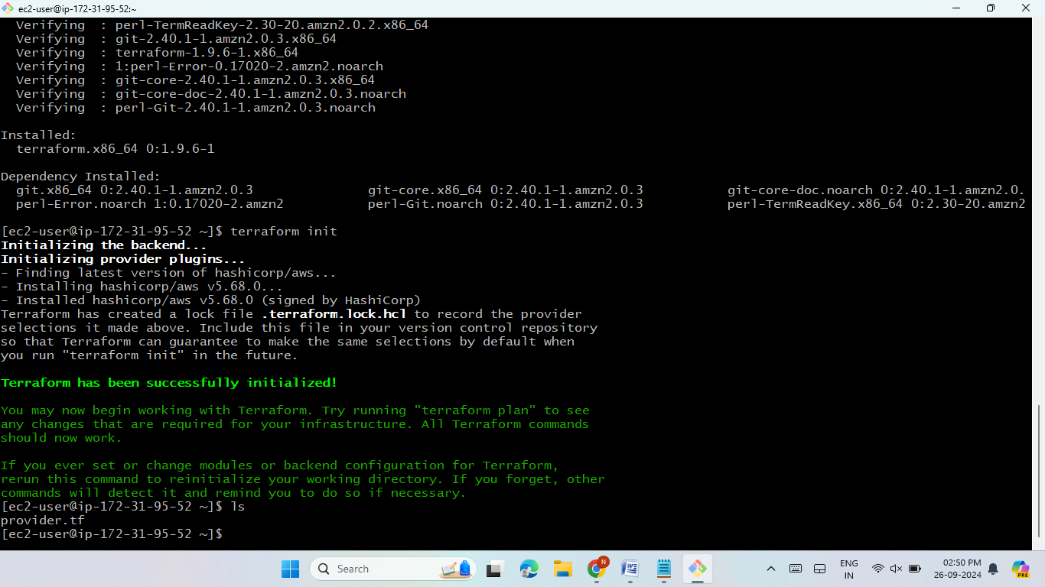
Initial Setup
Terraform Installation:
Installed Terraform on an EC2 instance.
Provided AWS access keys and secret keys for authentication.
Terraform Provider:
Defined the AWS provider in Terraform to communicate with AWS resources.
Enter the teraform init command to initialized the terraform.

Slide 5


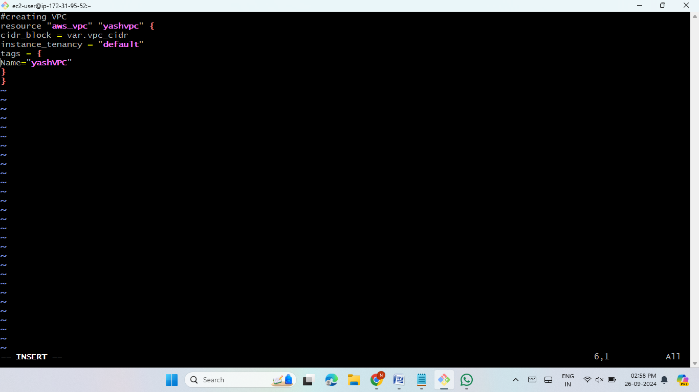
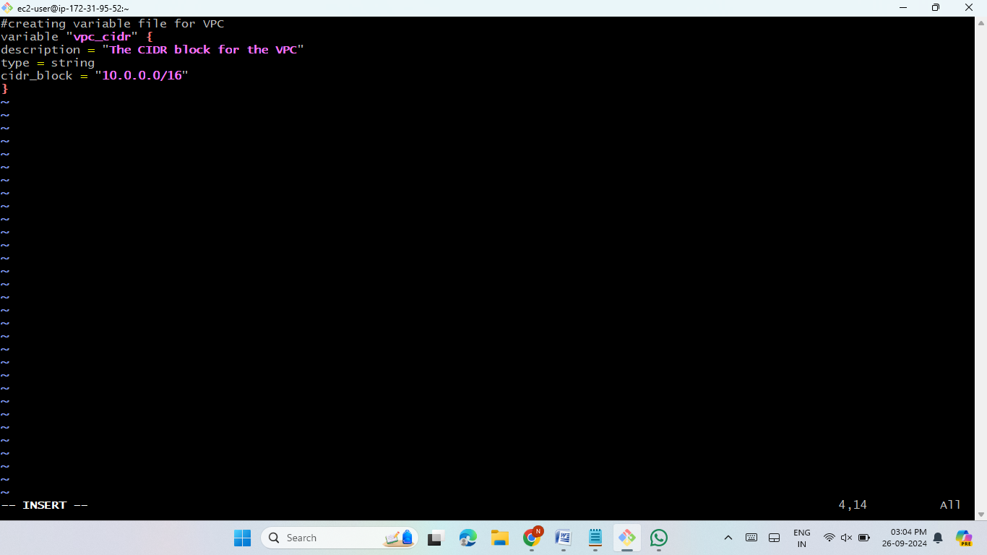
VPC Creation
Creating the VPC (vpc.tf)
Defined a VPC using a CIDR block.
VPC Variable File:
Created a variable file to manage dynamic
values in the VPC.

Slide 6
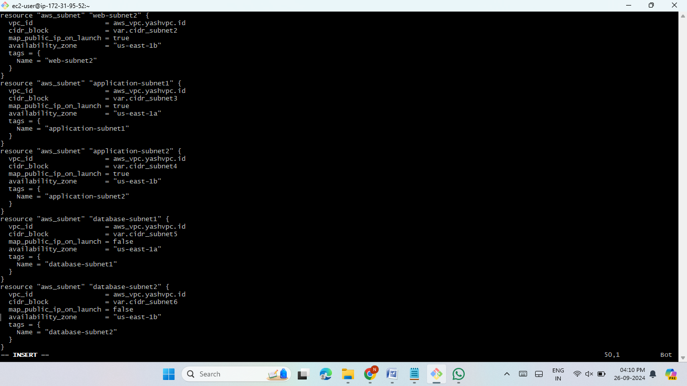
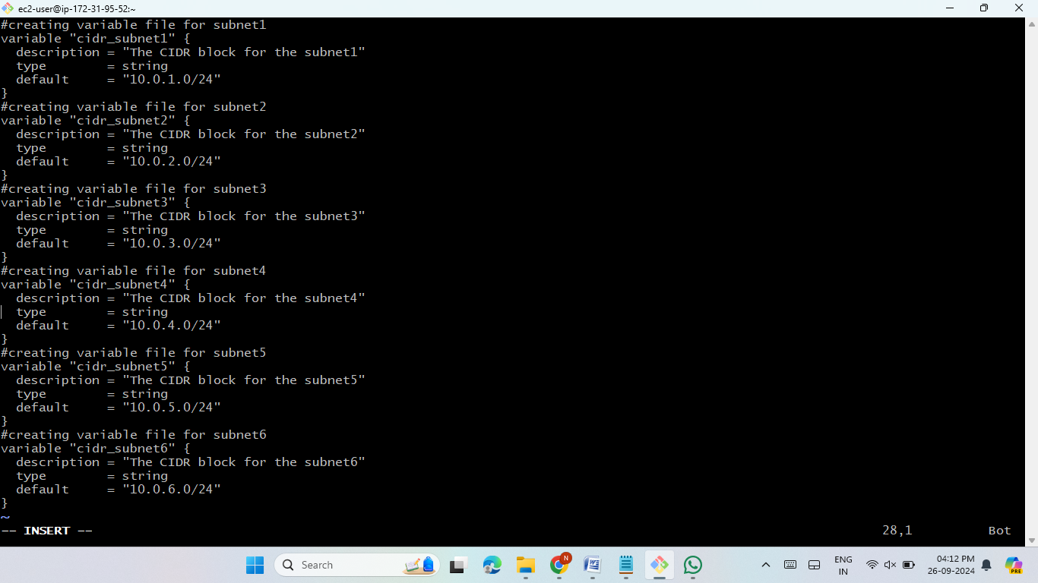
Subnet Configuration
Subnets (subnet.tf):
Created 6 subnets: 4 public and 2 private subnets for the front-end and back-end tiers.
Defined variable files for subnet configurations.

Slide 7
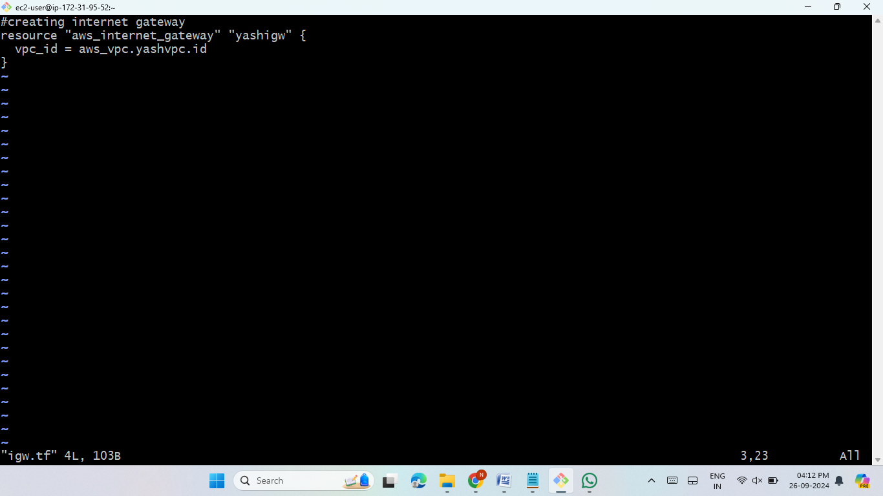
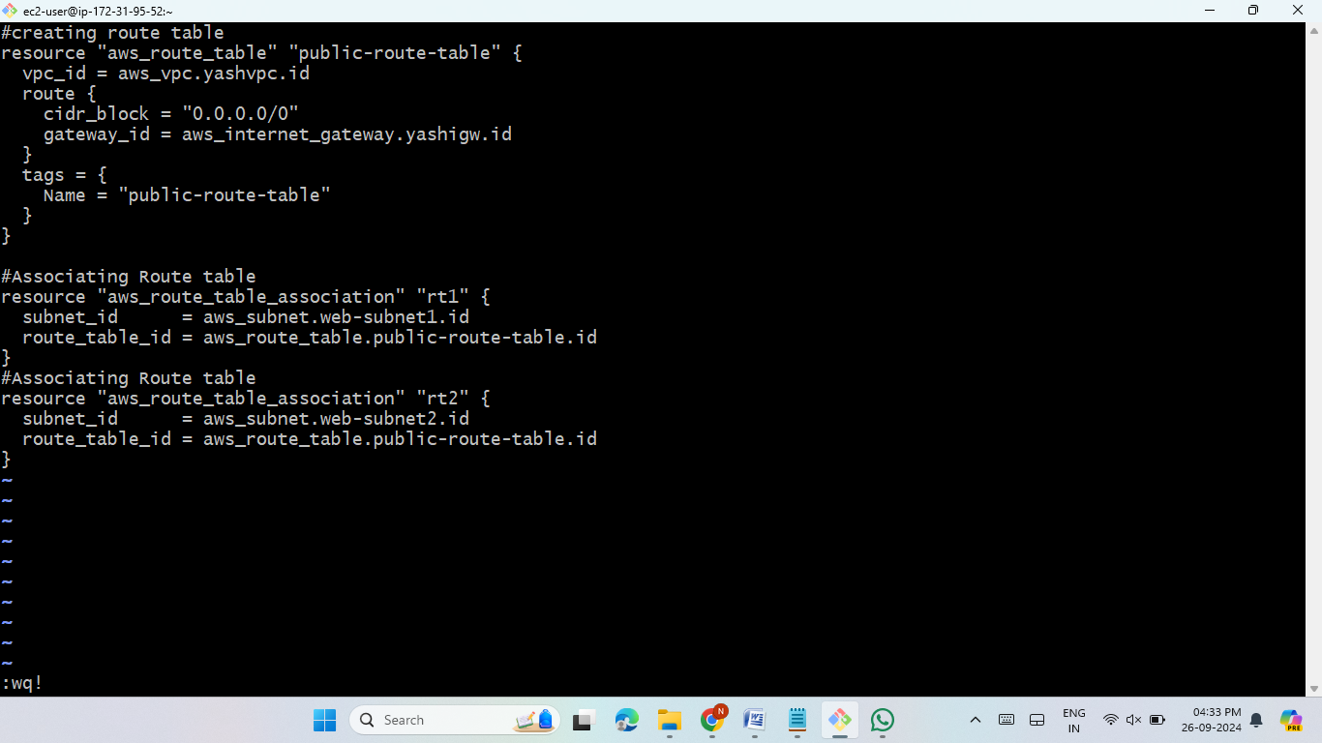
Internet Gateway & Route Tables
Internet Gateway (igw.tf):
Created an internet gateway .
Route Table (public-route-table.tf):
Configured route tables for routing
traffic to the public and private subnets.

Slide 8
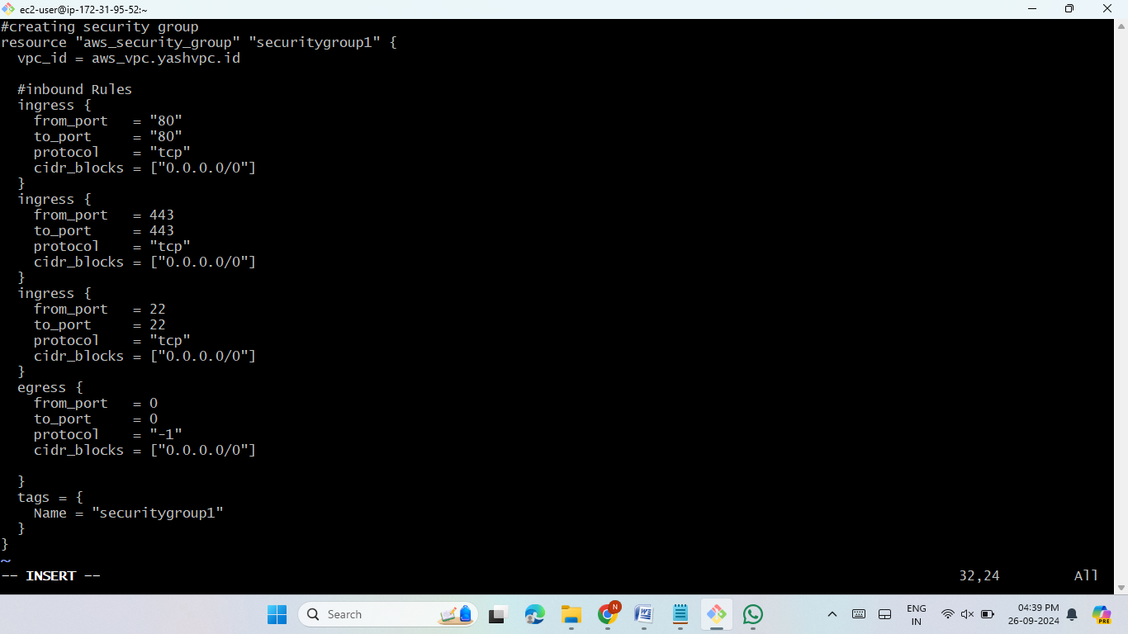
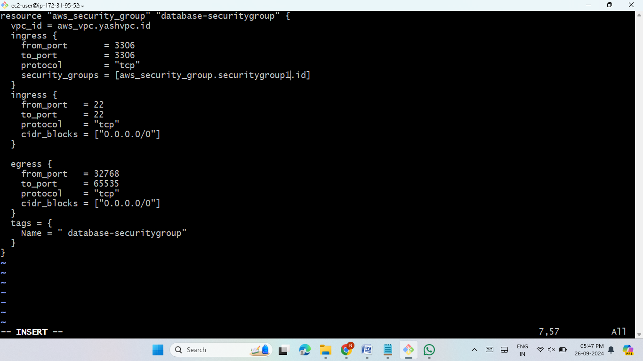
Security Groups
Instance Security Group (securitygroup1.tf):
Controls access to web servers.
Database Security Group (database-securitygroup.tf):
Secured access to the RDS instance.

Slide 9
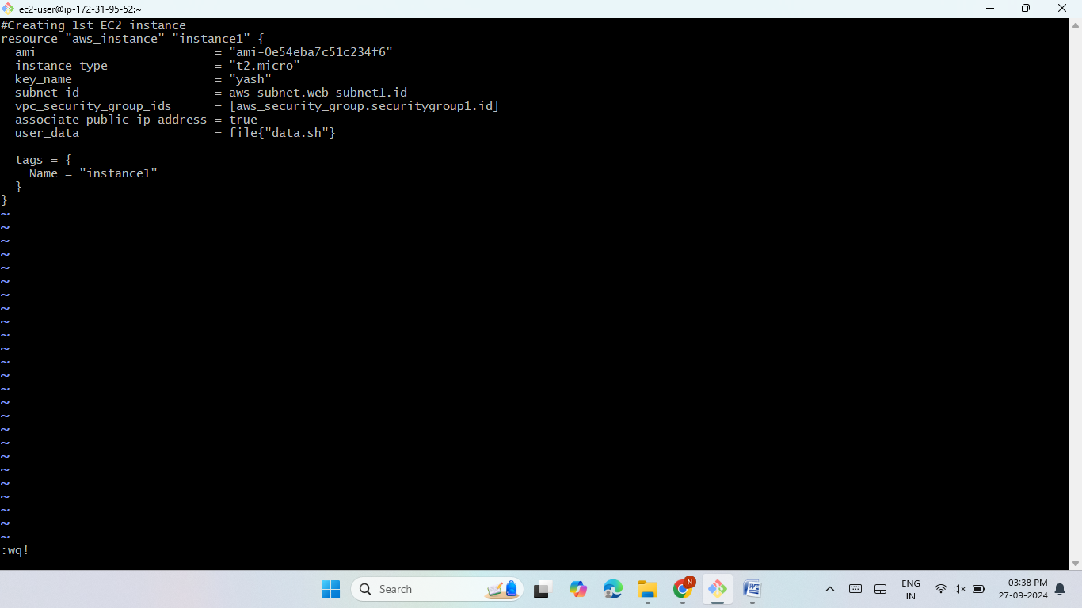

EC2 Instances
Create EC2 instances:
instance1.tf & instance2.tf for hosting the websites.
Installed necessary web server packages using a user data script.

Slide 10
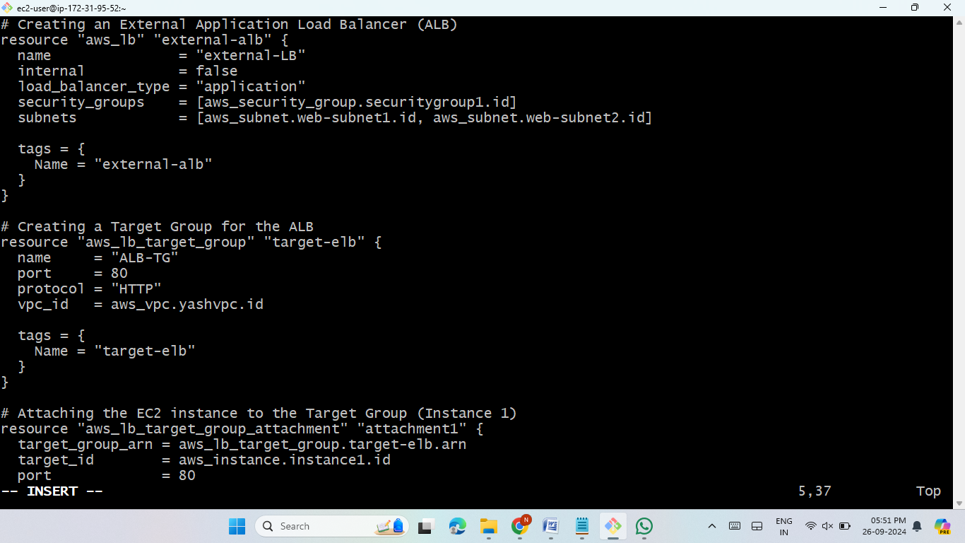
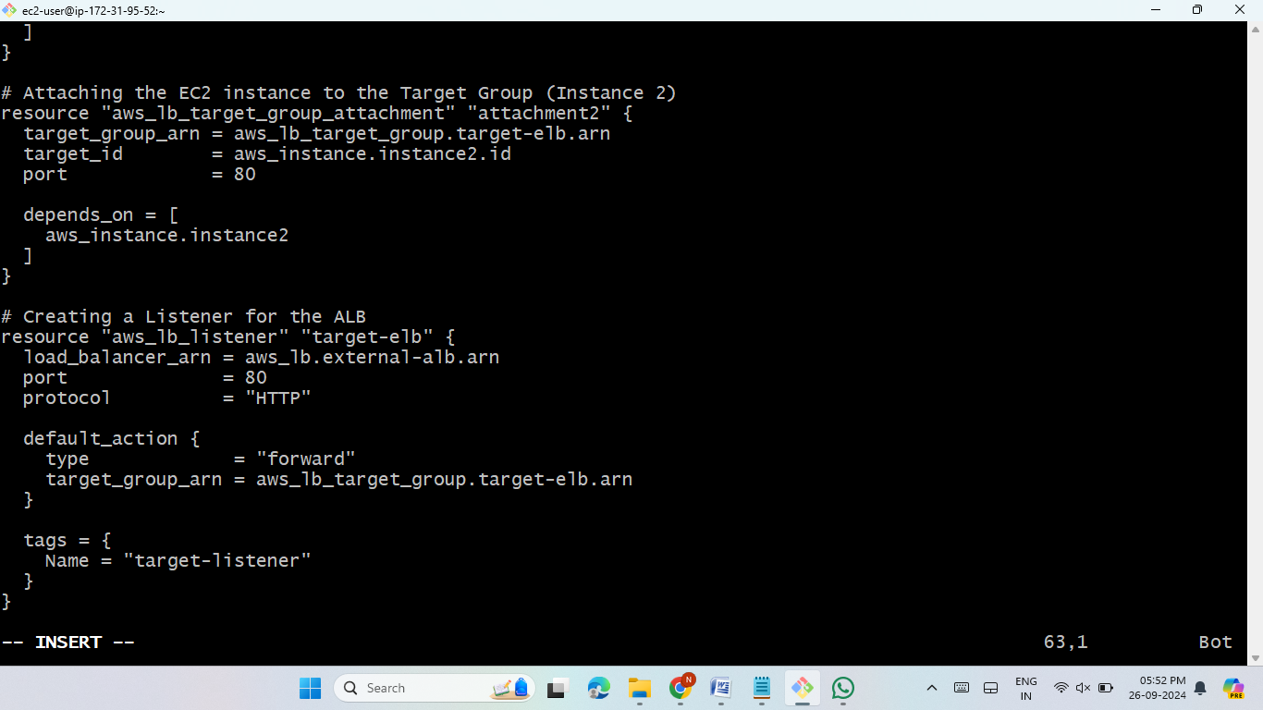
Application Load Balancer
Load Balancer & Target Groups (alb.tf):
Set up an Application Load Balancer (ALB) to distribute traffic.
Configured Target Groups to handle traffic routing to EC2 instances.

Slide 11
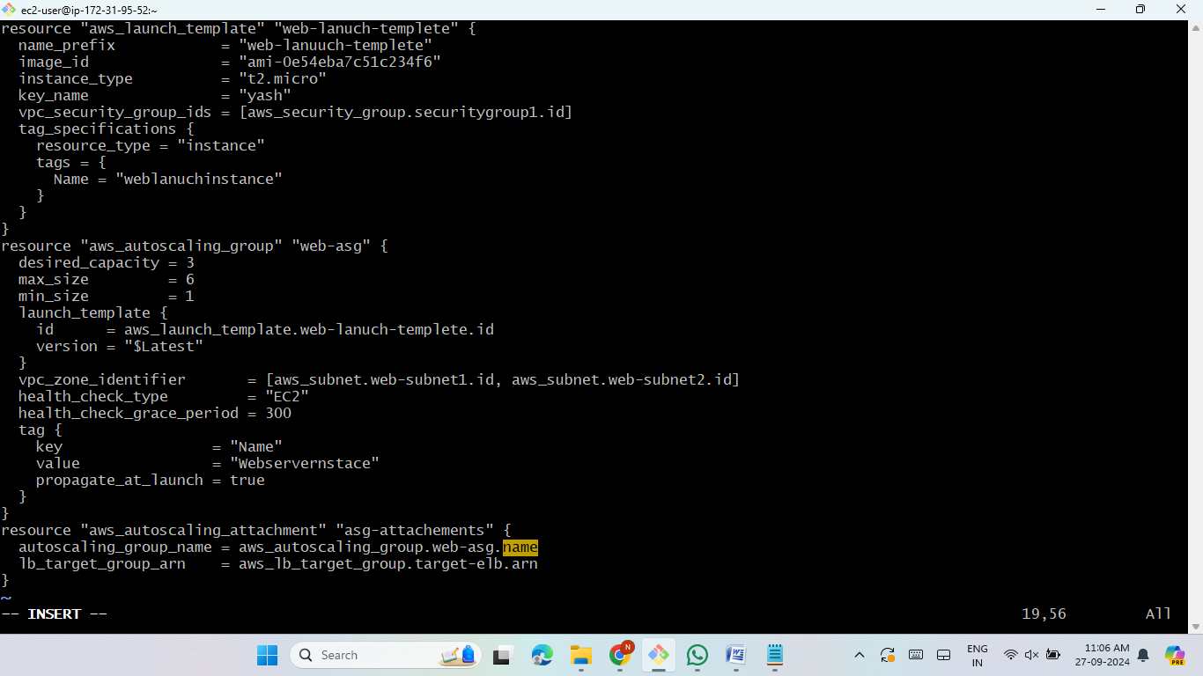
Auto Scaling Group
Configured Auto Scaling to maintain availability.
Automatically scales the EC2 instances
based on traffic load.
.

Slide 12

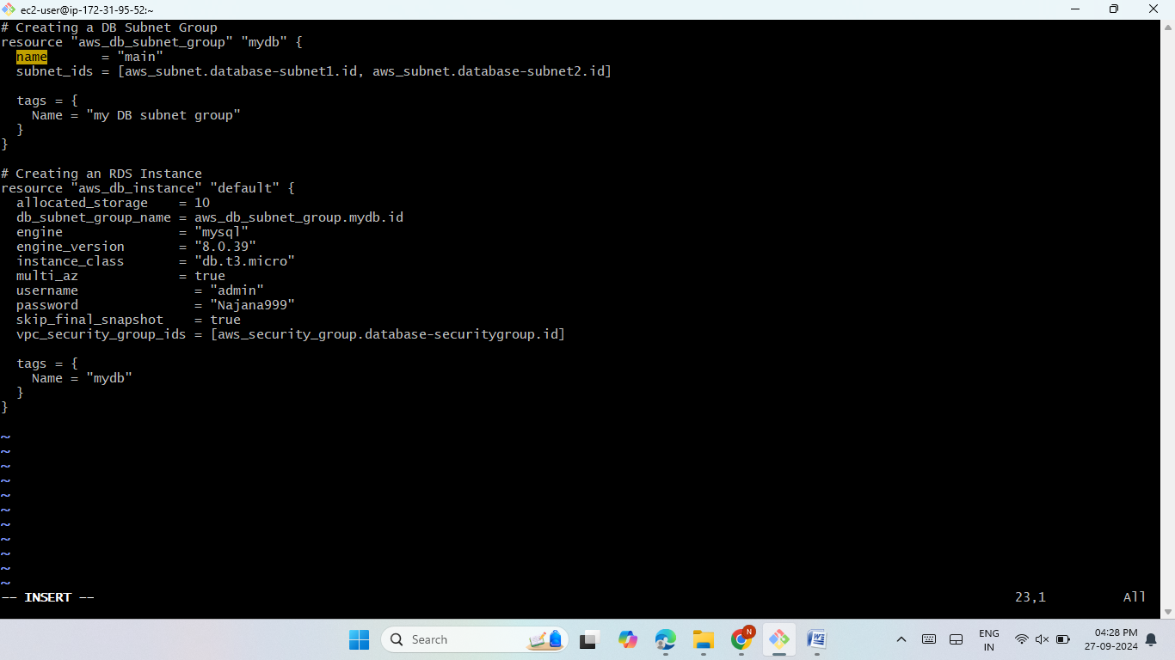
Relational Database Service
RDS Configuration (rds.tf):
Deployed an Amazon RDS MySQL instance for the database tier.
Secured access using a security group.

Slide 13

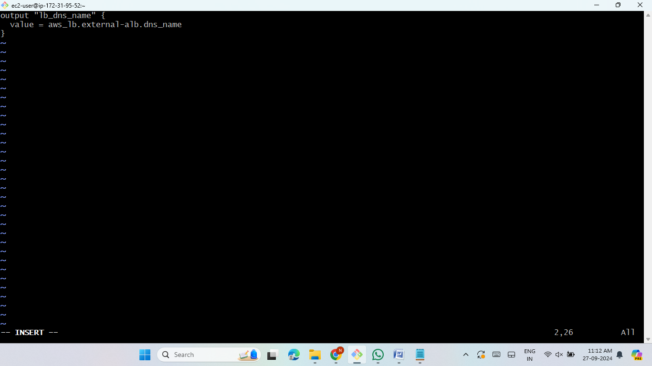
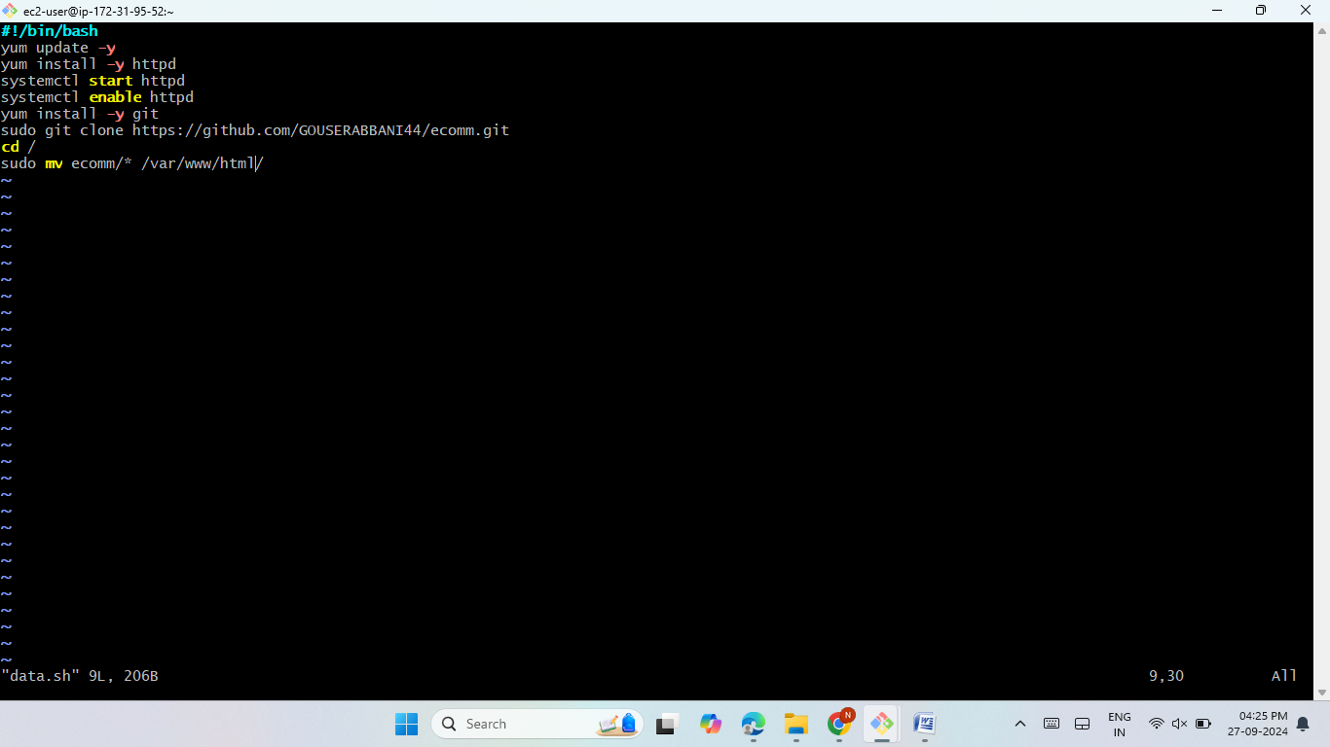
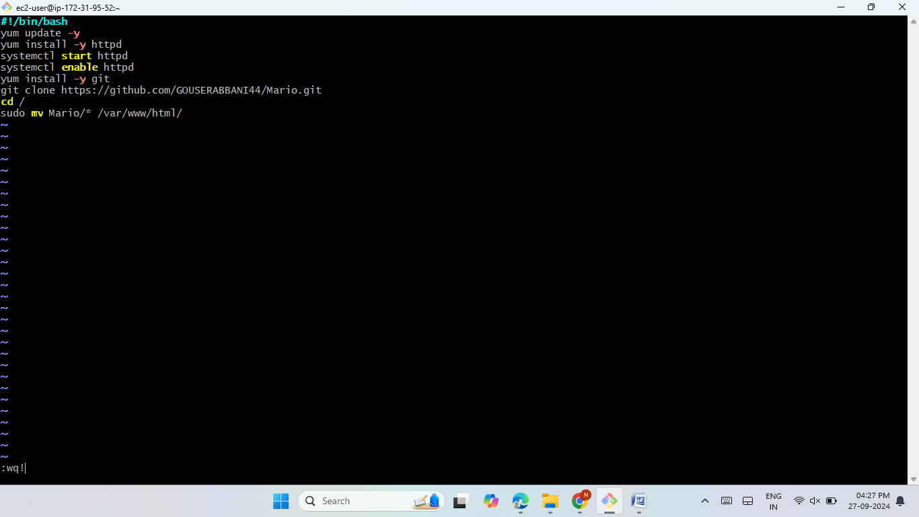
Output and User Data
Output File (output.tf):
Captured DNS of the load balancer for accessing hosted websites.
User Data Scripts:
Configured data.sh for ecomm.git website.
Configured data1.sh for Mario.git website.

Slide 14
Terraform Commands
terraform fmt (used to automatically format Terraform configuration files)
terraform validate (used to check whether a Terraform configuration is syntactically valid and internally consistent.)
terraform plan (used to create an execution plan, showing what actions Terraform will take to reach the desired state of your infrastructure based on your configuration files.)
terraform apply ( It executes the planned actions, such as creating, modifying, or destroying infrastructure resources, based on the configuration defined in.)

Slide 15
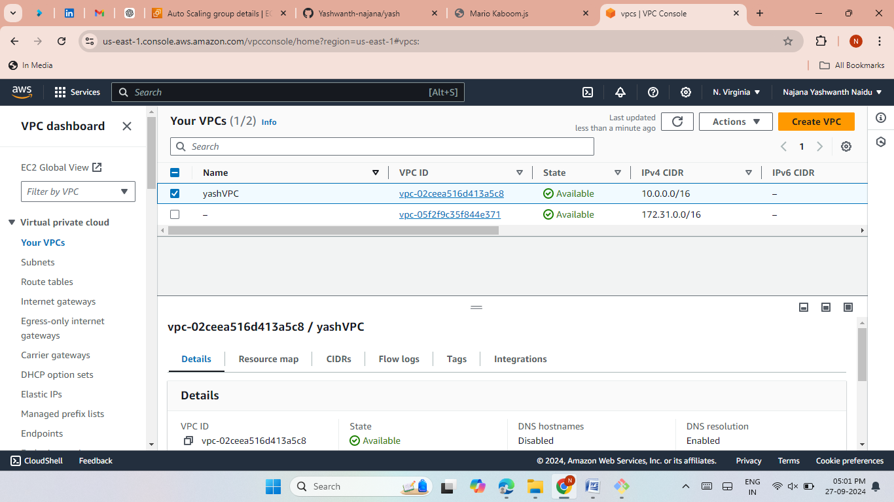
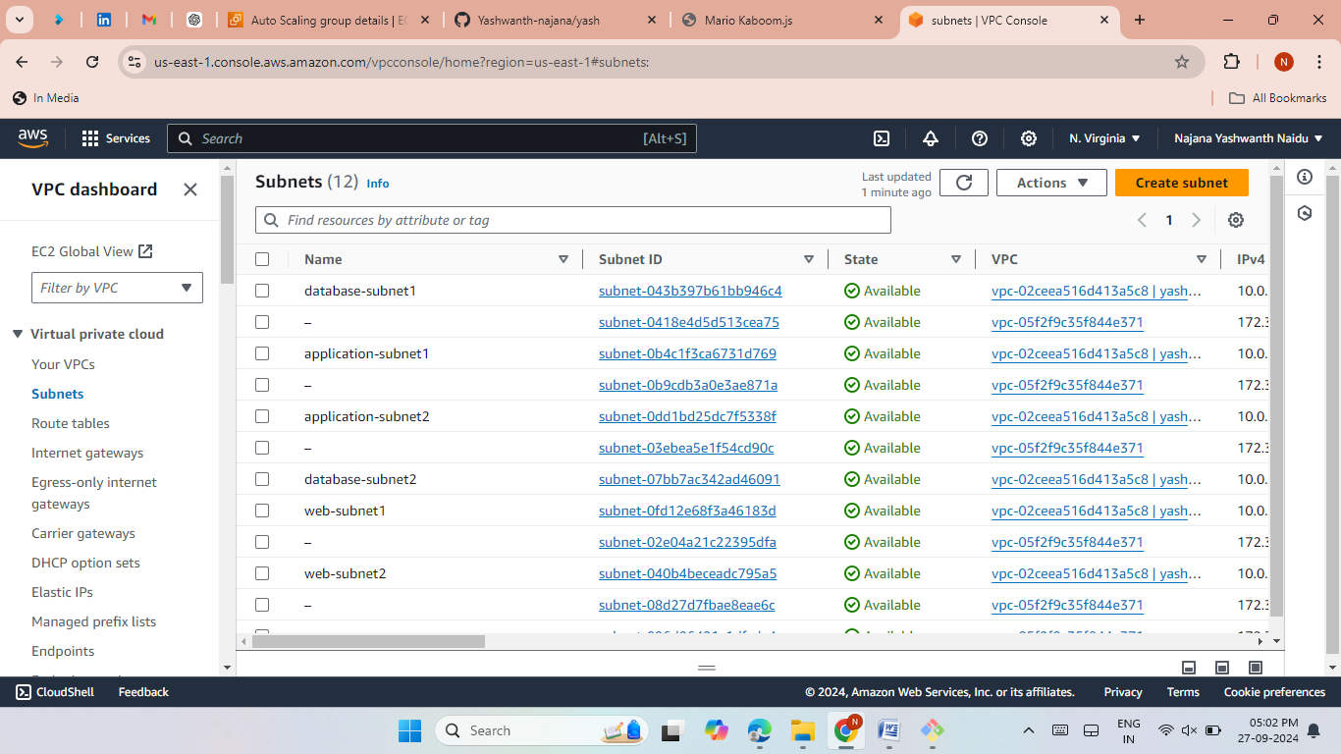
Verifying Resources
Verifications:
Verified creation of VPC, Subnets, Internet Gateway, Route Table ,Security Groups, EC2 Instances, and RDS Database,Load Balancing,Target Grouop and Auto-Scaling .

Slide 16
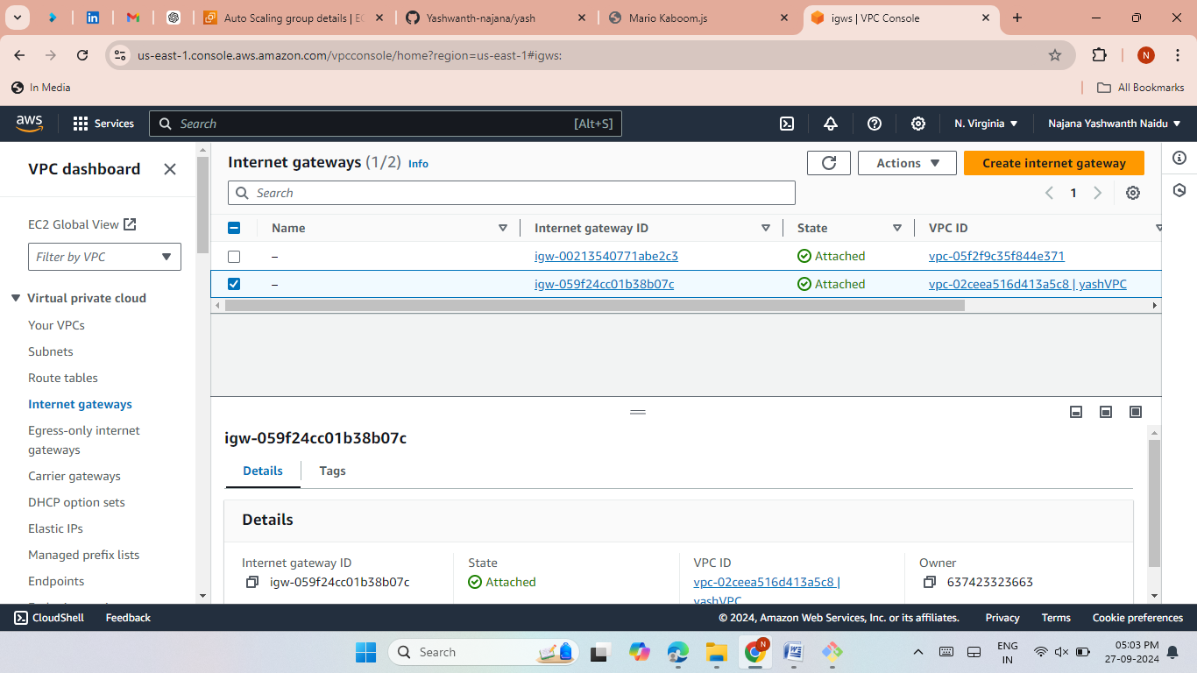
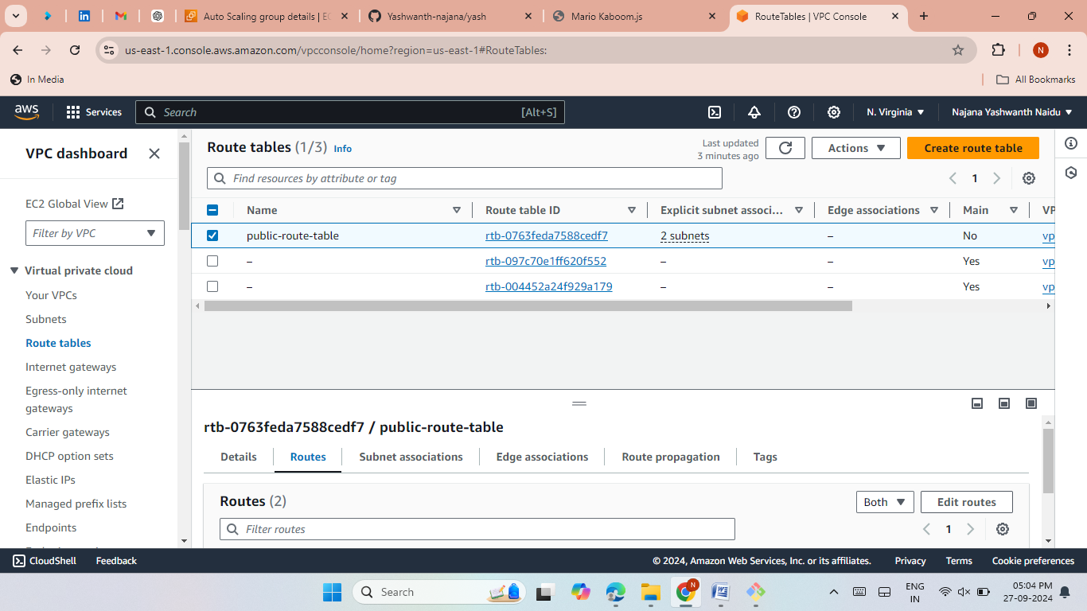
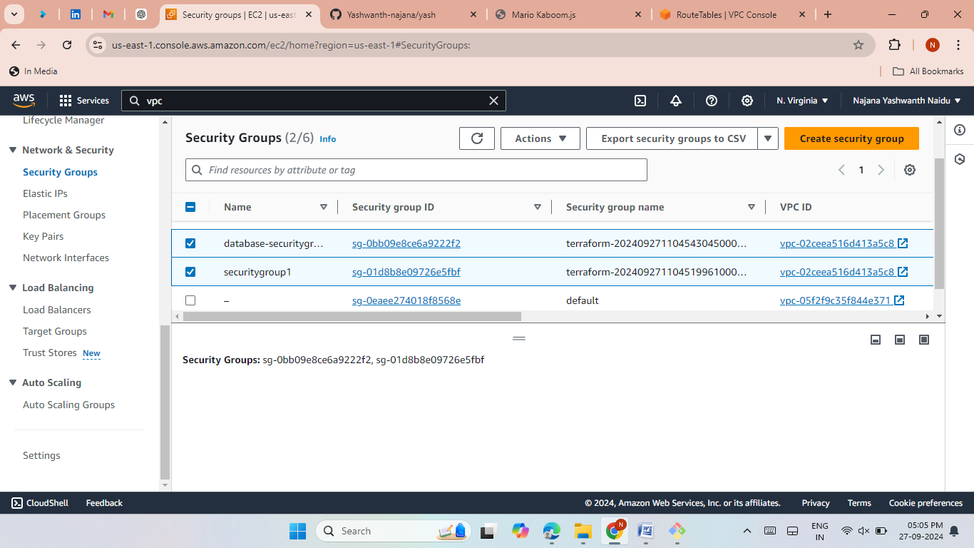
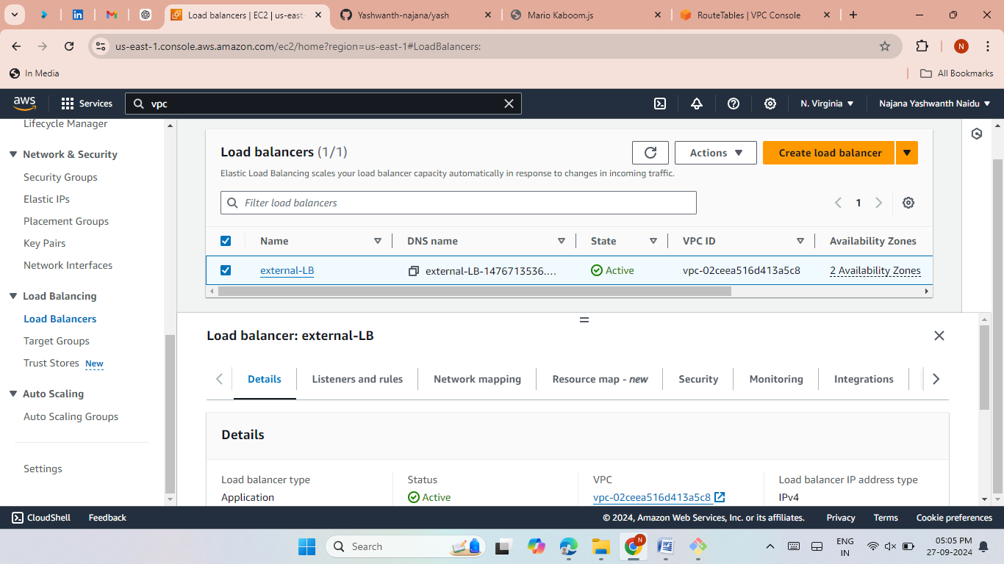
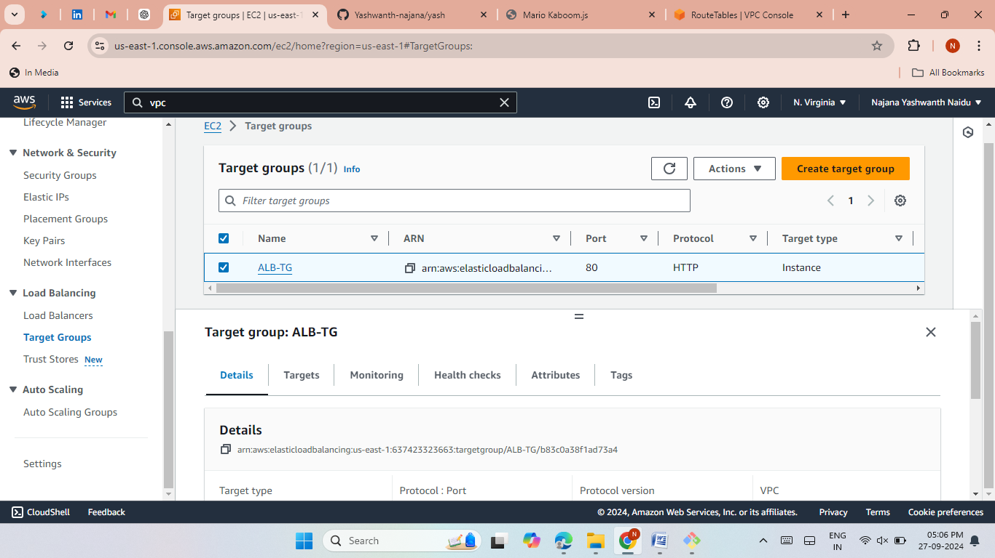
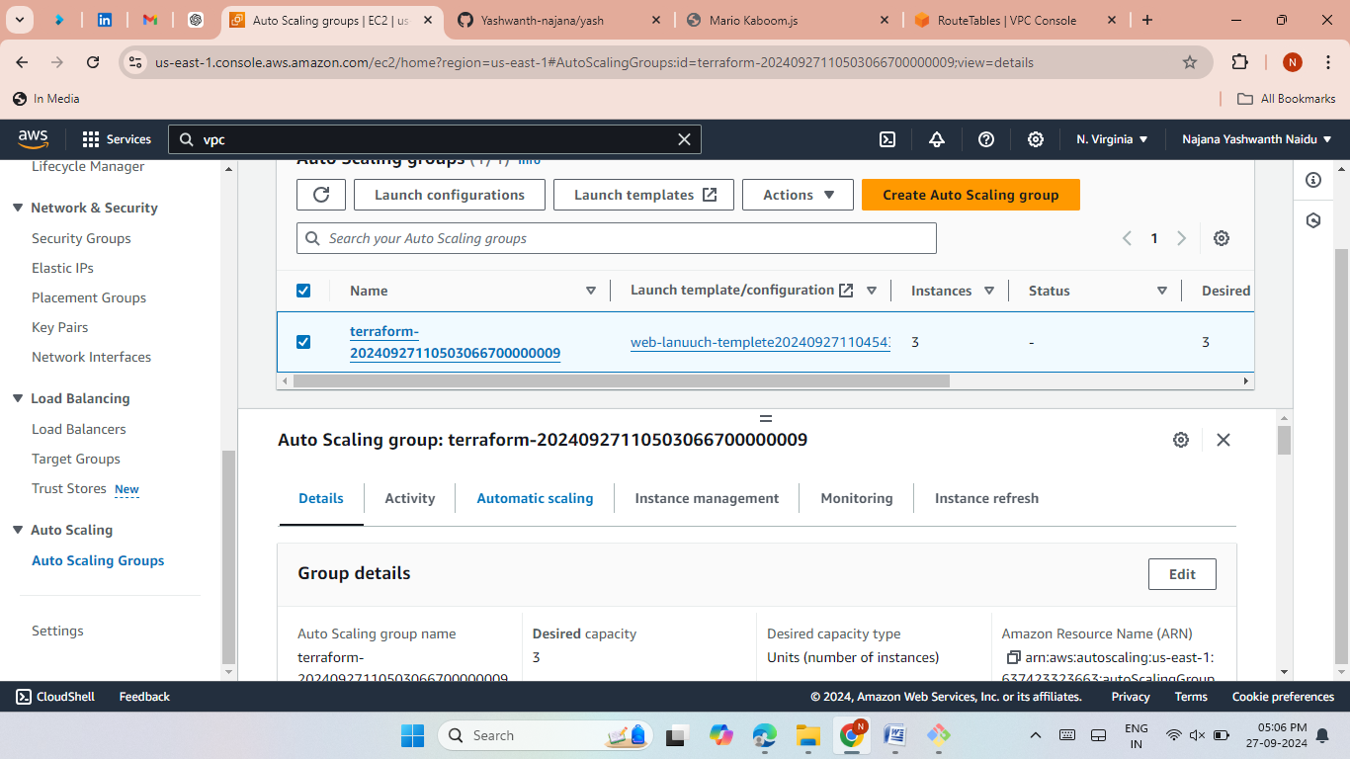

Slide 17
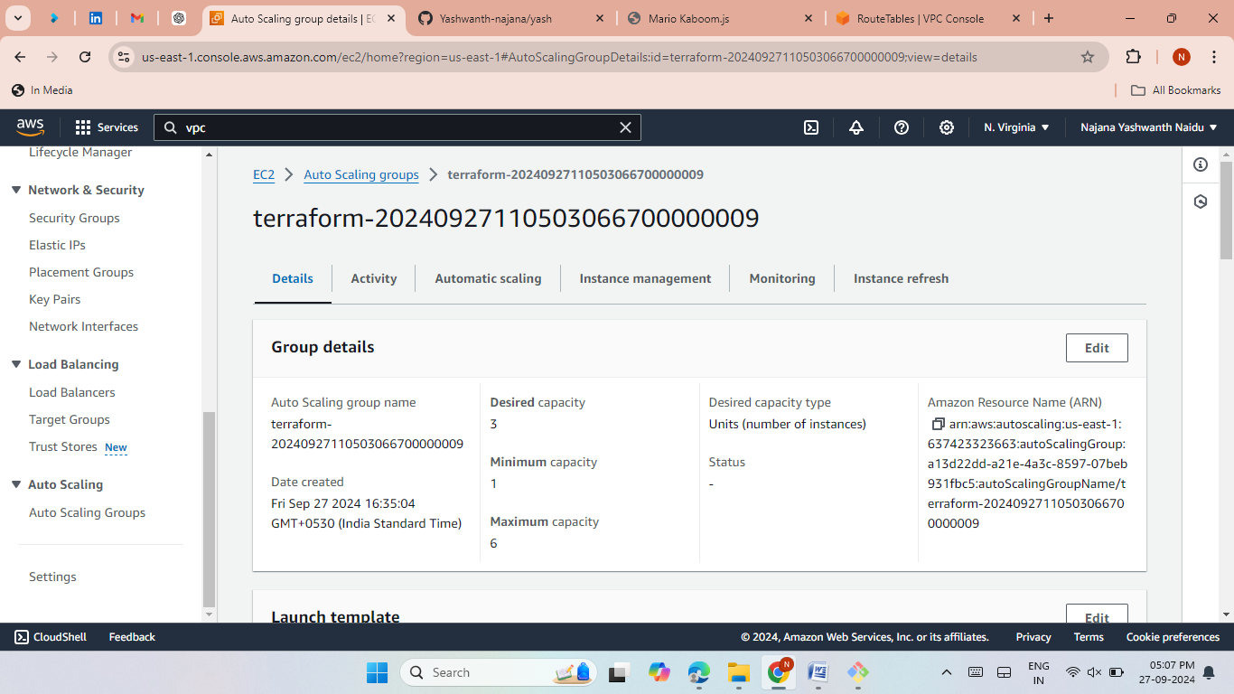
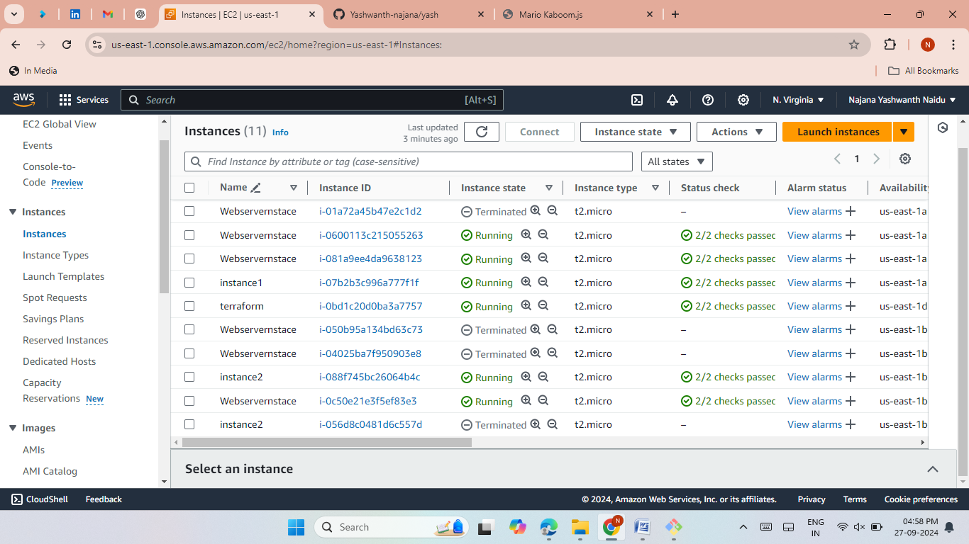
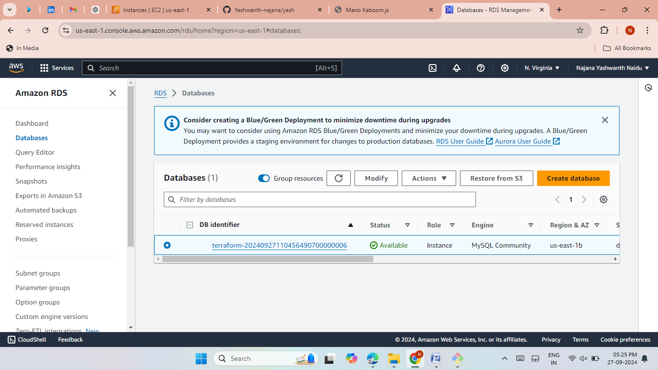
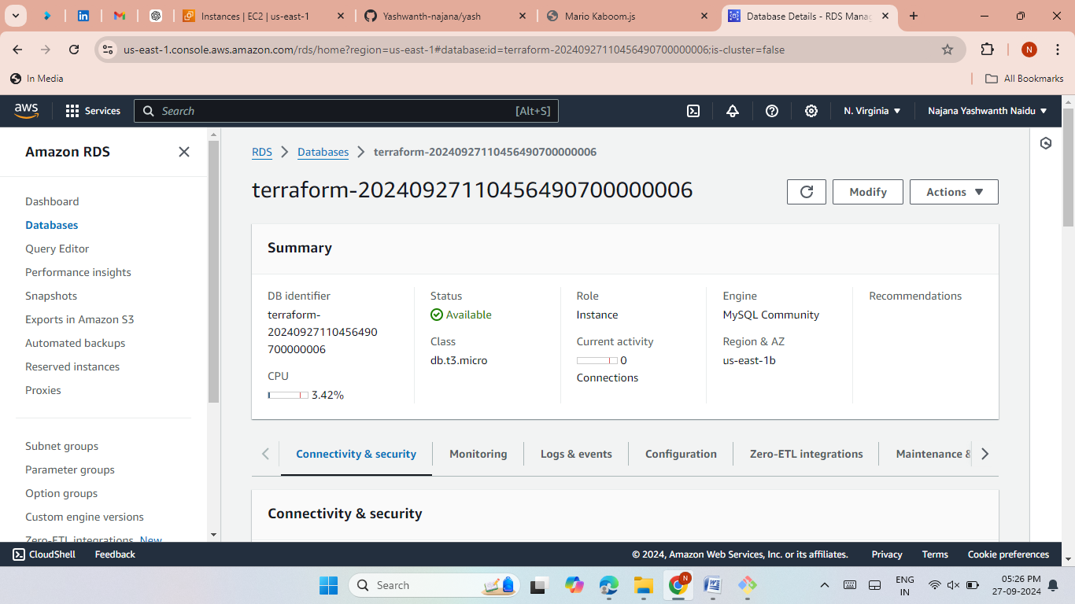

Slide 18
Hosting & Balancing Websites
Hosting Multiple Websites:
Successfully hosted ecomm and Mario websites using a single DNS.
Successfully hosted ecomm and food websites using a single DNS.
Balanced the load between multiple EC2 instances.

Slide 19

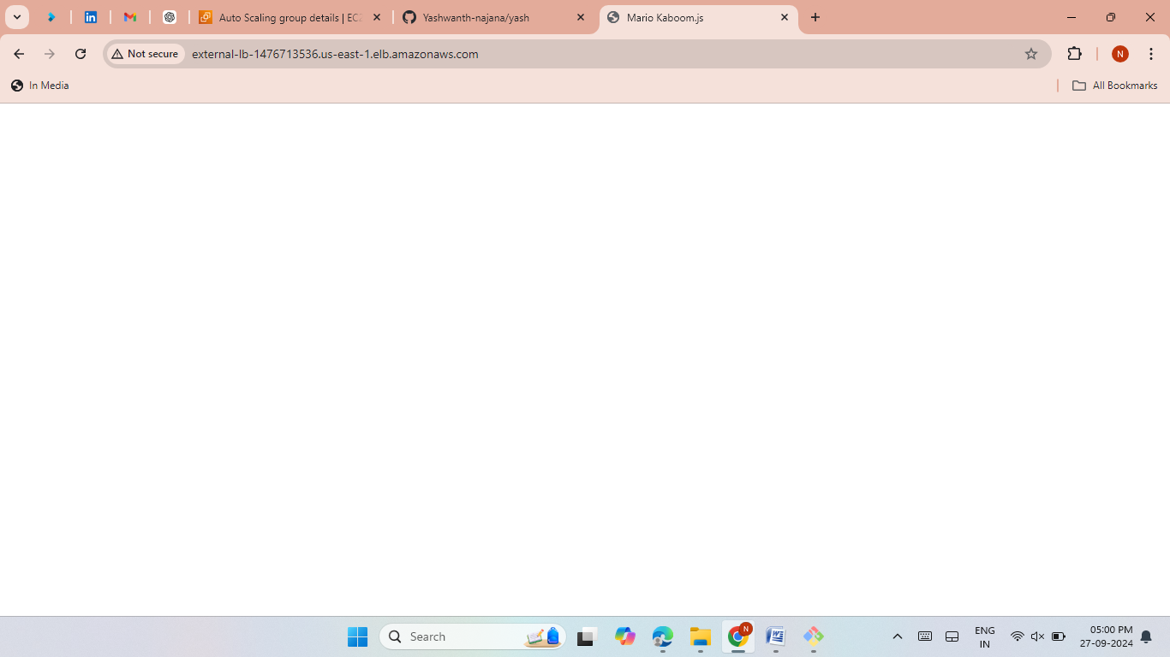



Slide 20
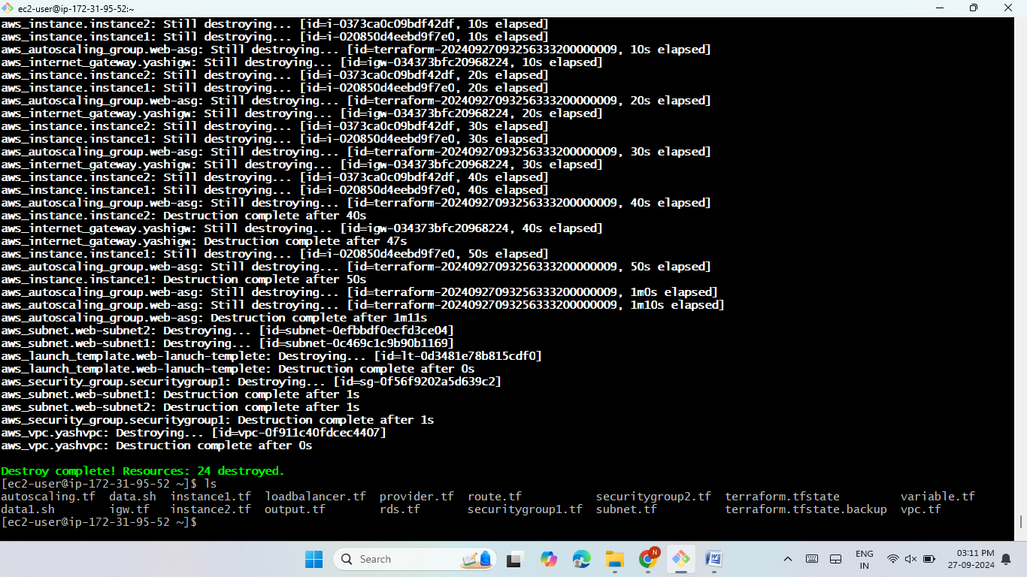

Resource Cleanup
Destroying Resources:
Use the terraform destroy command to clean up and remove all infrastructure.
This command removes all previously created resources.

Slide 21
Thank you!

